Slide 1

Lifestyle-Based Blood Pressure Prediction
Mera Mathew

Slide 2

Project Objectives
Develop a machine-learning model to predict Systolic (SBP) and Diastolic (DBP) blood pressure.
Use lifestyle, demographic, and dietary factors as input predictors.
Train and evaluate multiple algorithms.
Provide a non-diagnostic early screening tool.

Slide 3
Data Source and collection
NHANES survey cycles covering
August 2021 – August 2023
(publicly available at https://www.cdc.gov/nchs/nhanes/)
1
2
Combined several NHANES component datasets by joining on the unique participant ID

Slide 4
Data description
12 input features:
- Pulse Rate, Age, Gender, Race
- Weight, Height
- Sodium, Potassium, Calories Intake
- Smoking History & Drinks/Day
Target variables:
- Systolic Blood Pressure
- Diastolic Blood Pressure

Slide 5

Modeling Pipeline
• Data preprocessing:
- Handling categorical variables (OneHotEncoding)
- Scaling numeric features
- Train-test split (80/20)
• Models evaluated:
- ElasticNet
- Random Forest
- Gradient Boosting
• Evaluation metrics:
- MAE, RMSE, R²

Slide 6
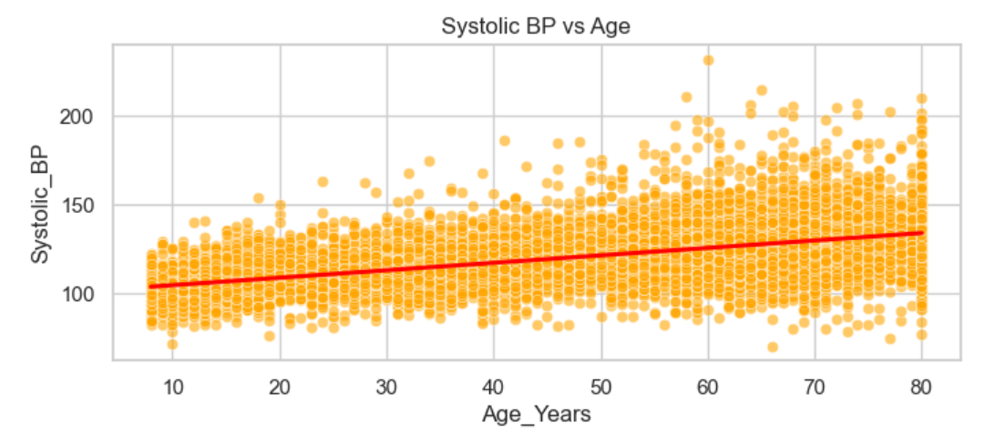
Key Observations from EDA

Slide 7
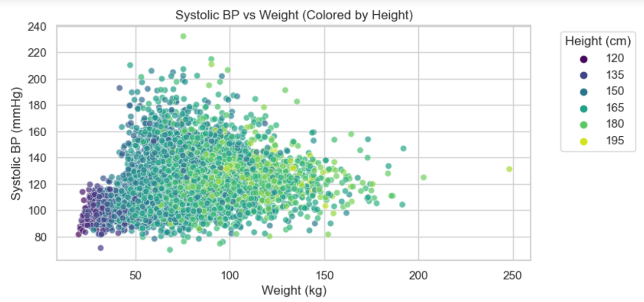
Key Observations from EDA

Slide 8
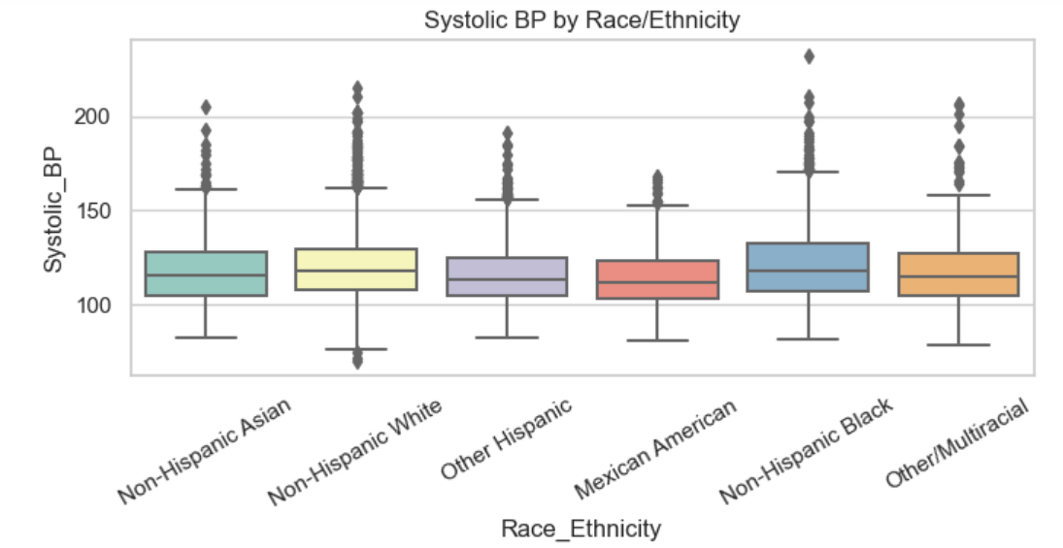
Key Observations from EDA

Slide 9
Best Model: Random Forest
Systolic BP:
- MAE: 8.8 mmHg
- RMSE: 12.16 mmHg
- R²: 0.55
• Systolic BP:
Diastolic BP
-MAE: 5.69 mmHg
- RMSE: 7.53 mmHg
- R²: 0.57
Comparable to medical research standards - R² between 0.30 and 0.60.
Errors (MAE 8–12 mmHg) fall within clinically acceptable screening levels.

Slide 10
Top Contributing Features
• Age
• Weight
• Height
• Sodium & Potassium intake
• Pulse Rate
• Smoking Status
• Drinks per Day

Slide 11
Streamlit Application
• Built interactive BP prediction UI
• Inputs required:
- Age, Pulse Rate, Weight, Height
- Sodium, Potassium, Calories
- Smoking history, Drinks per day
• Outputs:
- Predicted Systolic & Diastolic BP
- Hypertension Risk Category

Slide 12
• Early-stage hypertension risk screening
• Useful for clinicians & wellness programs
• Lightweight web tool for public health outreach
Impact

Slide 13
•Personalized lifestyle recommendations
1
•Long‑term risk forecasting
2
•Integration with wearable devices
3
Use Cases

Slide 14
Future scope:
- Real clinical dataset testing
- Deep learning models
- SHAP-based explainability

Slide 15

Thank you
Mera Mathew
meram1@ymbc.edu

